Slide 1
Module-2
Water Treatment
Topics: Water softening methods: - Lime-soda, Zeolite and ion exchange processes and their applications. Specifications of water for domestic use (ICMR and WHO); Unit processes involved in water treatment for municipal supply - Sedimentation with coagulant- Sand Filtration - chlorination; Domestic water purification – Candle filtration- activated carbon filtration; Disinfection methods - Ultrafiltration, UV treatment, Ozonolysis, Reverse Osmosis; Electro dialysis.

Slide 2
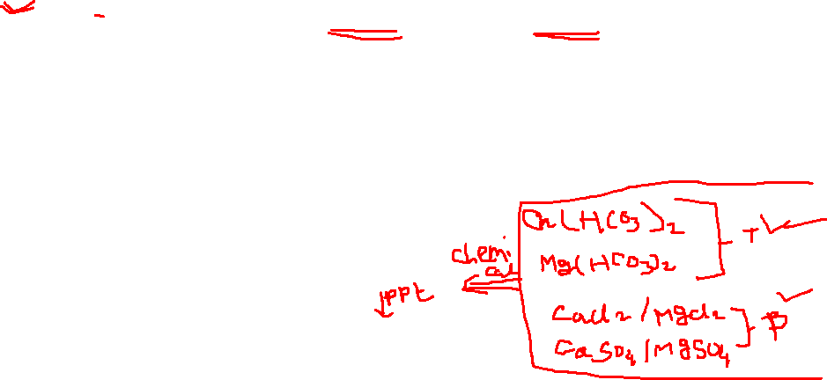
Water Softening methods
The process of removing the hardness producing substance from the water is called softening of water
In Industry three main methods are employed for softening of water
Lime soda process: lime Ca(OH)₂ and soda Na₂CO₃ is added; (residual hardness: 15 to 60 ppm)
Zeolite (permutit) process: Hard water is filtered through a natural sand called the zeolite (residual hardness: up to10 ppm)
Ion-exchange and Mixed bed ion-exchange process:
Cation exchange resins (RH⁺)
Anion exchange resins (R’OH⁻)
Mixed bed ion-exchange

Slide 3
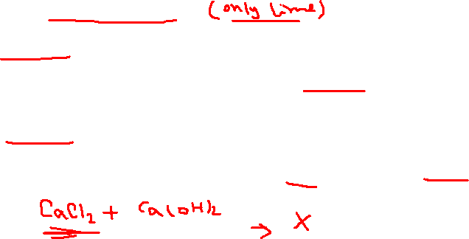
Basic principles of Lime-soda process
In this process, all the soluble hardness-causing impurities are converted into insoluble precipitates which may be removed by setting and filtration
Lime [Ca(OH)₂] and soda [Na₂CO₃] are the reagents used to precipitate the dissolved salts of Ca²⁺ and Mg²⁺ as CaCO₃ and Mg(OH)₂.
Lime removes the temporary hardness
Reaction of Ca(HCO₃)₂ :
Ca(HCO₃)₂ + Ca(OH)₂ 2 CaCO₃ + 2 H₂O
Reaction of Mg(HCO₃)₂ :
Mg(HCO₃)₂ + 2 Ca(OH)₂ 2 CaCO₃ + 2 H₂O + Mg(OH)₂
Lime cannot remove the calcium permanent hardness which should be removed by soda

Slide 4
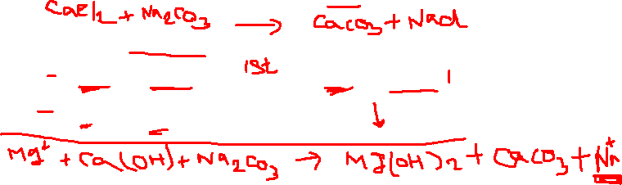
Basic principles of Lime-soda process
a. Reaction of permanent calcium:
Ca²⁺ + Na₂CO₃ CaCO₃ + 2Na⁺
b. Reactions of permanent magnesium:
Mg²⁺ + Ca(OH)₂ Ca²⁺ + Mg(OH)₂
Ca²⁺ + Na₂CO₃ CaCO₃ + 2Na⁺
Lime cannot remove the calcium permanent hardness which should be removed by soda

Slide 5

Lime Soda Process - Reactions of Lime and Soda
Lime removes the temporary hardness:
Ca(HCO₃)₂ + Ca(OH)₂ → 2 CaCO₃ ↓ + 2 H₂O
Mg(HCO₃)₂ + 2 Ca(OH)₂ → 2 CaCO₃ ↓ + MgCO₃ ↓ + 2 H₂O
Soda and Lime removes the magnesium permanent hardness:
MgCl₂ + Ca(OH)₂ → CaCl₂ + Mg(OH)₂ ↓
CaCl₂ + Na₂CO₃ → CaCO₃ ↓ + 2 NaCl
MgSO₄ + Ca(OH)₂ → CaSO₄ + Mg(OH)₂ ↓
CaSO₄ + Na₂CO₃ → CaCO₃ ↓ + Na₂SO₄

Slide 6
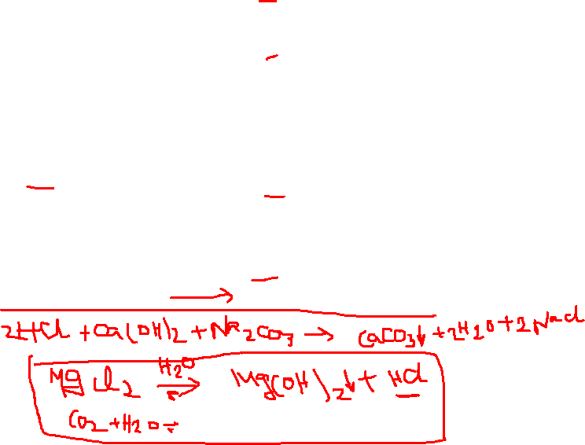
Soda removes all calcium permanent hardness:
CaCl₂ + Na₂CO₃ → CaCO₃ ↓ + 2 NaCl
CaSO₄ + Na₂CO₃ → CaCO₃ ↓ + Na₂SO₄
Reaction of CO₂:
CO₂ + Ca(OH)₂ CaCO₃ + H₂O
Reaction of H⁺:
2 H⁺ + Ca(OH)₂ Ca²⁺ + 2 H₂O
Ca²⁺ + Na₂CO₃ CaCO₃ + 2 Na⁺

Slide 7
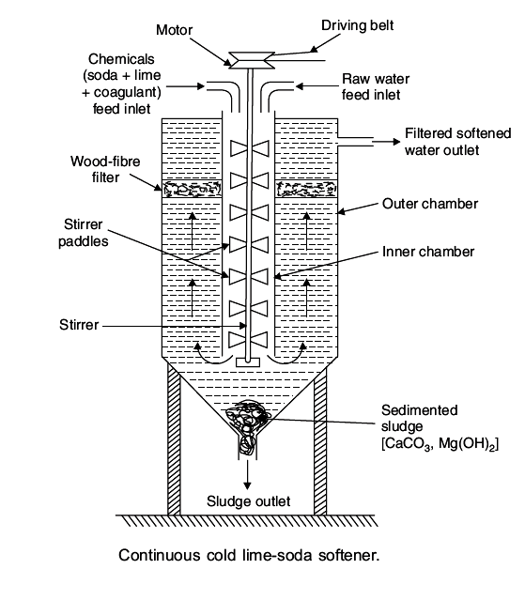
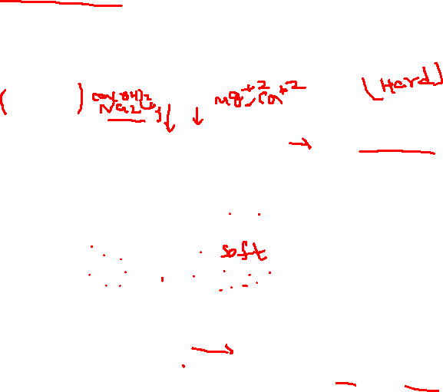
Working of Cold Lime –Soda Process

Slide 8

Operated at room temperature.
Calculated amount of lime & soda mixed with water at room temperature with stirring.
Precipitate formed are finely formed hence do not settle down easily.
It is essential to add small amount of coagulant [aluminium sulphate, sodium aluminate, Alum (K₂SO₄·Al₂(SO₄)₃·24H₂O)]
Coagulant hydrolyse to form gelatinous precipitates and entraps the fine precipitate
The softened water passes through a filtering media (wood fibre) for complete removal of sludge
It provides water with a residual hardness of 50 to 60 ppm.
2 NaAlO₂ + 4 H₂O → Al(OH)₃ ↓ + 2 NaOH
Al₂(SO₄)₃ + 3 Ca(HCO₃)₂ → 3 CaSO₄ + 2 Al(OH)₃ + 6 CO₂

Slide 9
Reactions of coagulants:
a) Reaction of FeSO₄:
Fe²⁺ + Ca(OH)₂ Fe(OH)₂ + Ca²⁺
Fe(OH)₂ + H₂O + O₂ 2 Fe(OH)₃
Ca²⁺ + Na₂CO₃ CaCO₃ + 2 Na
b) Reactions of Aluminium Sulphate (Al₂(SO₄)₃ :
2 Al³⁺ + 3 Ca(OH)₂ 2 Al(OH)₃ + 3 Ca²⁺
3 Ca²⁺ + 3 Na₂CO₃ 3 CaCO₃ + 6 Na⁺
c) Reactions of Sodium Aluminate (NaAlO₂):
NaAlO₂ + H₂O Al(OH)₃ + NaOH

Slide 10
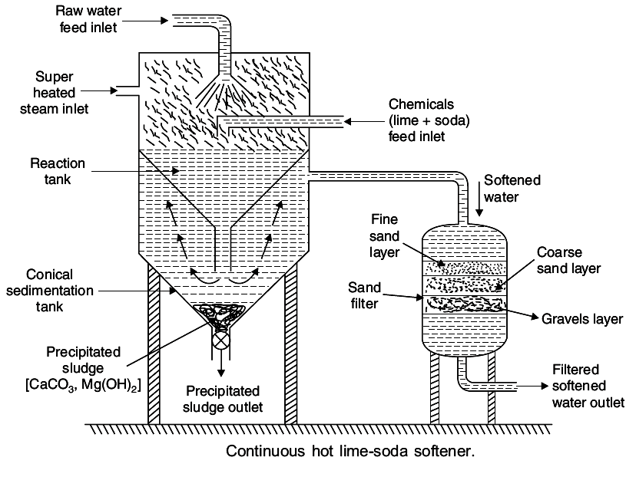

Hot Lime –Soda Process
Hot lime-soda process consists of three parts:
Reaction tank to mix all ingredients
b) Conical sedimentation vessel where the sludge settles down
c) Sand filter where sludge is completely removed
Advantages of hot lime-soda process:
The precipitation reactions are almost complete.
Reactions takes place faster.
Sludge settles down rapidly; No coagulant is needed.
Dissolved gases (which may cause corrosion) are removed.
Viscosity of soft water is lower, hence filtered easily.
Residual hardness is low compared to cold lime-soda process.

Slide 11

Difference Between Soft and Hot lime soda Process
Cold lime-soda process | Hot lime-soda process
Done at room temp, 25 to 30°C. | Elevated temperature, 94 to 100°C
Slow Process | Rapid process
Use of Coagulants is must | Coagulants are not required
Filtration is not easy | Filtration is easy since the viscosity is low at high temperature
Residual hardness is around 60ppm | Residual hardness is 15-30ppm
Dissolved gases are not removed | Dissolved gases like O₂ and CO₂ removed to some extent
Low softening capacity | High softening capacity

Slide 12
Advantages & disadvantages of lime-soda process:
Advantages of Lime – soda process:
Economical
Process improves the corrosion resistance of water.
Mineral content of water is reduced
The pH of water raises thus reducing content of pathogenic bacteria.
No skilled labour is required
Disadvantages of Lime – soda process:
Huge amount of sludge is formed and its disposal is difficult.
Due to residual hardness, water is not suitable for high pressure boilers.

Slide 13

Lime[Ca(OH)₂] required for softening
74
[ Temp. Ca²⁺ + 2×Temp. Mg²⁺ + Perm. (Mg²⁺ + Fe²⁺ + Al³⁺)
+ CO₂ + H⁺ (HCl or H₂SO₄) + HCO₃⁻] x Volume of water(V)
100
100 parts by mass of CaCO₃ ≡ 74 parts of Ca(OH)₂
1 part of CaCO₃ ≡ 74/100 of Lime
Soda [Na₂CO₃] required for softening
106
[ Perm. (Ca²⁺ + Mg²⁺ + Fe²⁺ + Al³⁺) + CO₂ + H⁺ (HCl or
H₂SO₄) - HCO₃⁻] x Volume of water (V)
100
100 parts by mass of CaCO₃ ≡ 106 parts of Ca(OH)₂
1 part of CaCO₃ ≡ 106/100 of Lime
All components in CaCO₃ equivalent
V = volume of water
Final result in mg >>> kg

